Slide 1

Visvesvaraya National Institute of Technology, Nagpur
Electronics and Communication Engineering Department
Executive M.Tech. in Applied AI & Communication
Cohort- 3A & 3B, Sem-3
Final Evaluation (10/05/2026)
NATURAL LANGUAGE PROCESSING
LABORATORY (ECL-545)
Automated Analysis of Meter Testing Remarks
Presented by-
Group No.-09
Ishita Sood (MT24AAI165)
Shubham Saxena (MT24AAC034)
Under the supervision of
Prof. Saugata Sinha
VNIT Nagpur

Slide 2
Contents
Problem Statement
Dataset Structure
Results Obtained
Contributon of Each Members
Tools and Technologies
Preview of GitHub Repository

Slide 3
Problem Statement
Problem Statement:
In utility meter testing operations, site engineers enter textual remarks during testing and inspection activities. These remarks are manually analyzed and forwarded to concerned departments such as:
Field Operation/Meter Testing
Meter Replacement/Installation
Network/Zone Maintainance
Customer Care/Call Center
CEG/Enforcement/Vigilance
Manual routing:
consumes time
increases human dependency
may cause incorrect routing
delays complaint resolution
Hence, an AI-based intelligent routing system is required that can automatically understand meter testing remarks and predict the appropriate concerned department with high accuracy.
Project Objective:
To automate meter testing remark analysis using AI and NLP.
To reduce manual intervention in complaint routing.
To classify remarks into concerned departments automatically.
To generate confidence scores for predictions.
To support bulk CSV-based prediction for real-time utility operations.
To compare performance of multiple ML/DL models.
Meter Testing Remarks → Standard Action Categories

Slide 4
Dataset Structure
Dataset Structure:
Training Data: Historical meter testing remarks with department labels used for model training.
Testing Data: New unseen remarks used for model testing and validation.
Source of Data: Real-time utility meter testing records and manually labeled departmental routing data.
Structure & Description of Dataset:
Text Remarks: Meter Testing remarks entered by engineers
Action Category: Actual Concerned department label
# Sample of Dataset:
Parameter | Training Dataset | Testing Dataset
Purpose | Model learning | Model evaluation
Data Used | Historical labeled remarks | Unseen new remarks
Number of Columns | 2 Columns | 2 Columns
Column Names | Input Feature: [TEXT_REMARKS], Output Label: [ACTION_CATEGORY] | Input Fetture: [TEXT_REMARKS], Output Label*: [ACTION_CATEGORY]
Dataset Size | 15524 Records** (12,736 OK; 2788 Not OK) | 10509 Records (8243 OK, 2266 Not OK)
Cancellation Code | 27 Different Cancellation Codes | Same as Training Dataset
Department Classes | 8 Departments | Same as Training Dataset
Sample Structure | Text Remark → Action Category ‘Department’ | Text Remark → Action Category ‘Department’
* Here Ouput Label is taken to get “Final Prediction” Confusion Matrix.
** This 15524 is reduced to 5958 (3314: OK; 2644: NOT OK) to avoid Baising towards Tested OK cases.
TEXT_REMARKS | ACTION_CATEGORY
accuacheck connection not possible in unsafe conditions | Field Operations / Meter Testing
B PHASE VOLTAGE MISSING | Network / Zone Maintenance Team
Battery low is showing on meter displayMeter need to be replacement required | Meter Replacement / Installation Team
CONSUMER NOT PROVIDE KEY SO METER COULDNT BE TESTED AT THE TIME OF TESTING | Field Operations / Meter Testing
Consumer refused to test the meter sunil Kumar | Back-Office / Administrative Operations
Cover open event appear on meter displayrefer to CEG | CEG / Enforcement / Vigilance Team
Notes:
Key Advantage of TF-IDF Vectorization:
- Assigns higher weights to important domain-specific words
- Produces high-dimensional sparse feature vectors
- Reduces influence of common but less meaningful terms

Slide 5
Results Obtained
Target Variable: Predicted Concerned Department
Model | Accuracy | Precision | Recall | F1-Score
Logistic Regression | 98.90 % | 96.57 % | 93.42 % | 95.14 %
SVM | 99.24 % | 98.85% | 97.14 % | 98.00%
ANN | 99.07 % | 98.85 % | 97.42 % | 98.14%
Models Used for Prediction:
1. Logistic Regression: Baseline ML classification model
2. Support Vector Machine (SVM):High-performance text classification model
3. Artificial Neural Network (ANN): Deep learning-based intelligent classification model
Meter Remarks
↓
Text Preprocessing
↓
TF-IDF Vectorization
↓
Model Training
(Logistic / SVM / ANN)
↓
Prediction
↓
Confidence Score
↓
Department Routing
↓
CSV Output Generation
TEXT_REMARKS | ACTION_CATEGORY | PREDICTED_DEPARTMENT | CONFIDENCE_SCORE | CONFIDENCE_RANGE | MATCH_STATUS
Enforcement ir found on meter | CEG / Enforcement / Vigilance Team | CEG / Enforcement / Vigilance Team | 83.36 | 90-75% High | Correct
as per system meter retain | Scheduling / Field Dispatch Team | Meter Replacement / Installation Team | 64.9 | 75-50% Medium | Wrong
Current Parameter of Phase and Neutral is not matching therefore same is defective | Meter Replacement / Installation Team | Meter Replacement / Installation Team | 97.33 | 100-90% Very High | Correct
As per Consumer Wrong notification Generated Take by Sageeta ji Daughter in law | Scheduling / Field Dispatch Team | Field Operations / Meter Testing | 46.17 | Below 50% Low | Wrong
Consumer dont want to test their meter as their query already resolved hence this request needs to be closed Contacted Person Deepak | Scheduling / Field Dispatch Team | Back-Office / Administrative Operations | 52.97 | 75-50% Medium | Wrong
consumer refused to meter testing so could not be meter tested | Back-Office / Administrative Operations | Back-Office / Administrative Operations | 95.97 | 100-90% Very High | Correct
Notes:
Key Advantage of TF-IDF Vectorization:
- Assigns higher weights to important domain-specific words
- Produces high-dimensional sparse feature vectors
- Reduces influence of common but less meaningful terms

Slide 6
Contribution of Each Member
Ishita Sood [MT24AAI165]
NLP Model Development & Performance Analysis
Performed preprocessing of unstructured Site Engineer remarks including text cleaning and normalization
Implemented TF-IDF based textual feature extraction for NLP classification
Developed and trained Machine Learning models using Logistic Regression, Support Vector Machine (SVM), and Artificial Neural Network (ANN)
Executed multi-class department classification for automatic case routing
Evaluated and compared model performance using Accuracy, Precision, Recall, and F1-Score metrics
Performed prediction validation and comparative analysis for final model optimization and deployment readiness
Shubham Saxena [MT24AAC034]
Dataset Collection, Repository Management & Validation
Collected real-time meter testing remarks directly from utility testing databases and Site Engineer operational records
Organized and structured raw testing remarks with corresponding departmental routing labels for supervised learning
Created and maintained a centralized project repository for consolidation of datasets, source files, model outputs, and documentation
Performed data verification, consistency checking, and validation of departmental mappings for improved data quality
Prepared training and testing datasets using actual field-level utility operational data
Conducted testing on unseen real-world remarks and verified prediction outputs for routing accuracy and result validation
Notes:
Key Advantage of TF-IDF Vectorization:
- Assigns higher weights to important domain-specific words
- Produces high-dimensional sparse feature vectors
- Reduces influence of common but less meaningful terms

Slide 7
Tools & Technologies used :
Tools and Technologies Used:
GitHub Repository:
Project Objective:
AI-based intelligent routing system for automatic classification of utility meter testing remarks into concerned departments.
Project Files Available:
Source Code
Input Dataset
Preprocessed Dataset
Output CSV Files
ANN/SVM/LR Models
Project Documentation
GitHub Link:
https://github.com/shubham300701/AI-Meter-Remark-Classification.git
Tool / Technology | Purpose
Google Colab | Code execution and training
Python | Programming language
Pandas | Data handling
NumPy | Numerical operations
Scikit-learn | ML algorithms
TensorFlow / Keras | ANN model
TF-IDF | NLP vectorization
GitHub | Project hosting
The project successfully demonstrates the application of AI and NLP in utility meter testing operations for intelligent department routing.
The developed system reduces manual effort, improves routing efficiency, and supports smart utility automation using ANN, SVM, and Logistic Regression models.
Notes:
Key Advantage of TF-IDF Vectorization:
- Assigns higher weights to important domain-specific words
- Produces high-dimensional sparse feature vectors
- Reduces influence of common but less meaningful terms

Slide 8
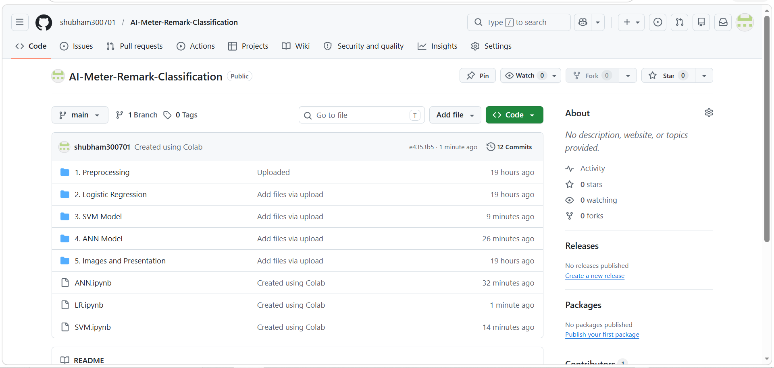
Preview of GitHub Repository:
https://github.com/shubham300701/AI-Meter-Remark-Classification.git
Notes:
Key Advantage of TF-IDF Vectorization:
- Assigns higher weights to important domain-specific words
- Produces high-dimensional sparse feature vectors
- Reduces influence of common but less meaningful terms

Slide 9
THANKS
We are open for questions.

